Slide 1
Managing Official Records using SharePoint Server 2007

Slide 2
Why Records Management?
Increased attention on corporate governance
Enron, Anderson, Worldcom
Increased Legislation
Fines
Penalties

Slide 3
Records Management Core Services
Confidentiality
Ensure the records are securely maintained
Prevent unauthorized access
Information Integrity
Prevent tampering with content or metadata
Prove no tampering has occurred
High Availability
Records available at all times
Records decoupled from other business processes
Avoid down time related to compliance
Adherence to Policy
Establish clearly defined policies
Ensure policies are consistently applied
Prove that policies were applied as described
Auditability
Log all changes to records
Log all record retrievals and submissions
Ensure that logs are accurate

Slide 4
Business Challenges
Regulatory Compliance / Worker Productivity
Regulatory Compliance / Infrastructure Costs
Regulatory Compliance / Complexity

Slide 5
Records Management in MOSS
Records Repository Site Template
Official Record Routing Infrastructure
Official File Web Service
Information Management Policy Architecture

Slide 6
How it Works

Slide 7
Processing Overview
Document library configured to send records
Official File WS called to get routing types
Routing types mapped to content types
File submitted with custom routing applied
Metadata is promoted to document library
Information management policies applied

Slide 8
Setting up a Records Repository
Use the built-in Records Center site template
Add a document library to receive files
Setup record routing types

Slide 9
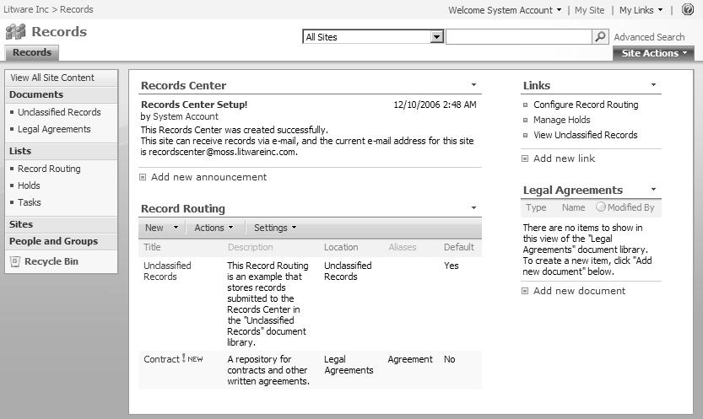

Slide 10
Submitting Records from the UI
Configure the document library (admin)
Send documents to repository (user)

Slide 11
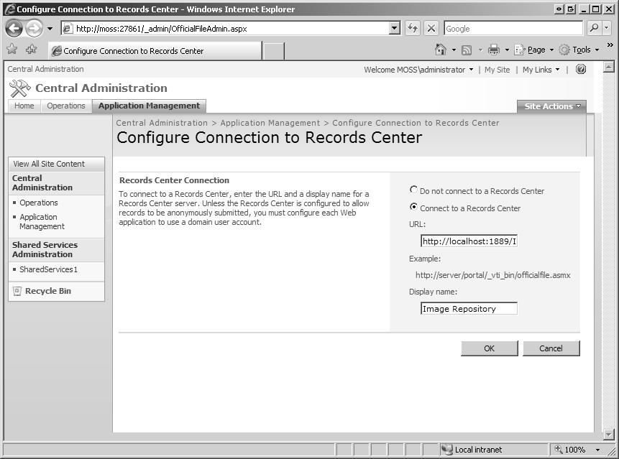
Configure Document Library
From Central Admin

Slide 12
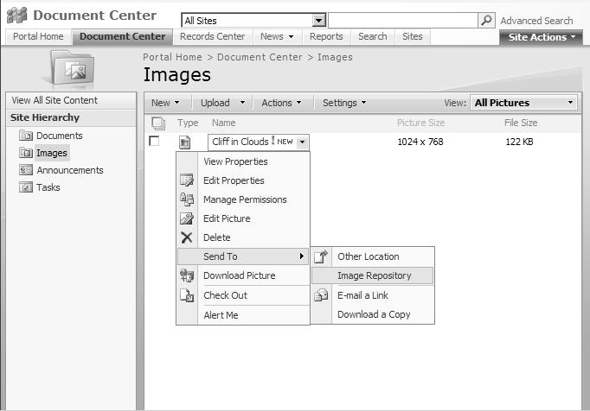
Send to Repository
From any library

Slide 13
Holds
Important for Litigation Support applications
Need to suspend normal processing
“Freeze” orders from court
Prevent files from being changed or deleted

Slide 14
Holds Architecture

Slide 15
DEMO Building and Configuring a Records Repository

Slide 16
Using the SharePoint OfficialFile Web Service

Slide 17
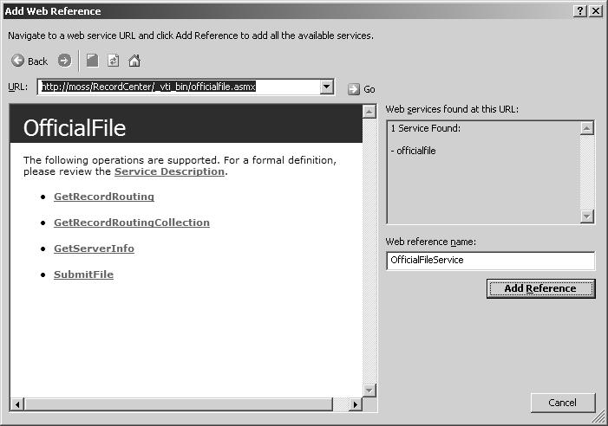
Official File Web Service
Only 4 methods
Relatively easy to implement

Slide 18
Record Routing Collection

Slide 19
Submitting Records using Code
Add a web reference to the Official File WS
Connect to the repository
Get the available record routing types
Submit the file

Slide 20
ValidateRepository()
/// <summary>
/// Determines whether the specified repository is available.
/// </summary>
private bool ValidateRepository(OfficialFileService.RecordsRepository repository)
{
bool isValid = false;
try {
isValid = repository.GetRecordRoutingCollection().Length > 0;
} catch {}
return isValid;
}

Slide 21
Connecting to the Repository
// Get the web service proxy and point it at the designated url.
m_repository = new OfficialFileService.RecordsRepository();
m_repository.Credentials = System.Net.CredentialCache.DefaultCredentials;
m_repository.Url = repositoryUrl.Text;
if (ValidateRepository(m_repository))
{
// Get the list of available record routing types.
string rTypes = m_repository.GetRecordRoutingCollection();
string expr = "/RecordRoutingCollection/RecordRouting/Name";
XPathDocument doc = new XPathDocument(new StringReader(rTypes));
XPathNavigator nav = doc.CreateNavigator();
XPathNodeIterator iter = nav.Select(expr);
// Initialize the list of routing types in the UI
…
}

Slide 22
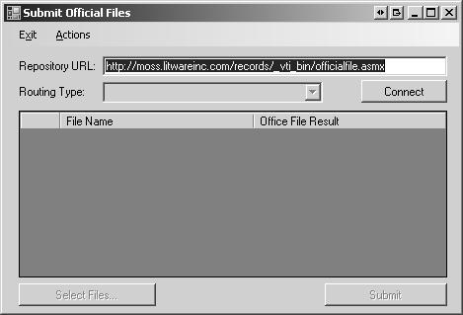
Official File Web Service Client
An example of how to connect to a repository using the Official File web service

Slide 23
DEMO: Using the Official File Web Service

Slide 24
The MOSS Record Routing Architecture

Slide 25
MOSS Supports Preventive Approach to Maintaining Record Integrity
Extensible Routing Framework
Write custom code to “route” incoming documents
Associate custom code with record series
One router per series
Same router for multiple series
Framework calls custom code when documents arrive
Code can accept or reject “invalid” documents

Slide 26
Why do we need custom routing?
Records management is driven by regulatory compliance => liability for non-compliance.
Confidentiality
Record Integrity
Adherence to Policy
Audit Ability
Handling of certain record types may change without having to restructure the repository
Key Scenarios:
Filtering
Tracking
Redirecting
Can be handled by custom routers

Slide 27
Key Scenario: Filtering
Filtering
Check incoming documents for metadata integrity
Flag potential problems
Incomplete metadata that might require fixups
Inconsistent or invalid metadata
Reject non-conforming documents
Missing digital signature
Not uniquely identified
Conflicts with other documents

Slide 28
Key Scenario: Tracking
Building an audit trail
Independent of SharePoint Content DB
Useful for auditors to prove no tampering
Useful for administrators
Ability to capture additional metrics
Can examine content + metadata
Can compile statistics as records pass through

Slide 29
Key Scenario: Redirecting
Classic Scenario
Storing records dynamically
Choose location based on algorithm(s)
Driven by content and/or metadata

Slide 30
MOSS Record Routing Architecture
RecordSeriesCache
RecordSeriesCollection
RouterResult
RecordSeries
IRouter
Router

Slide 31
Creating a Custom Router
Implement the IRouter interface
Add the custom router to a records center
Activate the router for a routing type

Slide 32
Router Configuration
using (SPSite site = new SPSite(url)) {
using (SPWeb web = site.OpenWeb()) {
try {
RecordSeriesCollection coll = new RecordSeriesCollection( web );
switch (command) {
case "REGISTER":
coll.AddRouter( ROUTER_NAME, ROUTER_ASSEMBLY, ROUTER_CLASS);
break;
case "UNREGISTER":
coll.RemoveRouter( ROUTER_NAME );
break;
}
} catch {}
}}

Slide 33
DEMO: Custom Router

Slide 34
Observations
MOSS allows only one router per record type.
Cannot easily apply multiple business rules
Reduces the value of record routing

Slide 35
Routing Wish List
More extensible routing framework
Ability to attach actions to incoming documents
Ability to attach multiple actions to the same document
Ability to add routing actions by activating a feature (installing an assembly)
Ability to administer routing actions

Slide 36
Summary
Records management is driven by regulatory compliance
An effective RM solution must meet core requirements of confidentiality, integrity, availability, adherence to policy and auditability
MOSS includes a default implementation that meets these requirements

Slide 37
Summary
The Official File web service provides a standards-based SOA platform for records management.
MOSS implements an extensible routing framework for processing records.
Information Management Policy enables governance of all aspects of enterprise content management.

